Slide 1
How to use GraphPad Prism: Michaelis-Menten Kinetics

Slide 2
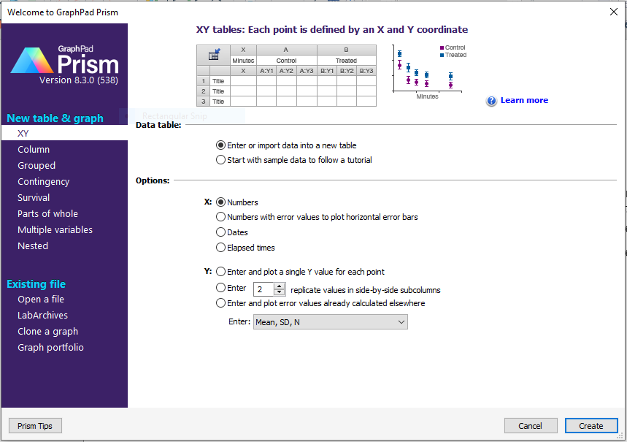
Initial screen when you start GraphPad Prism…

Slide 3
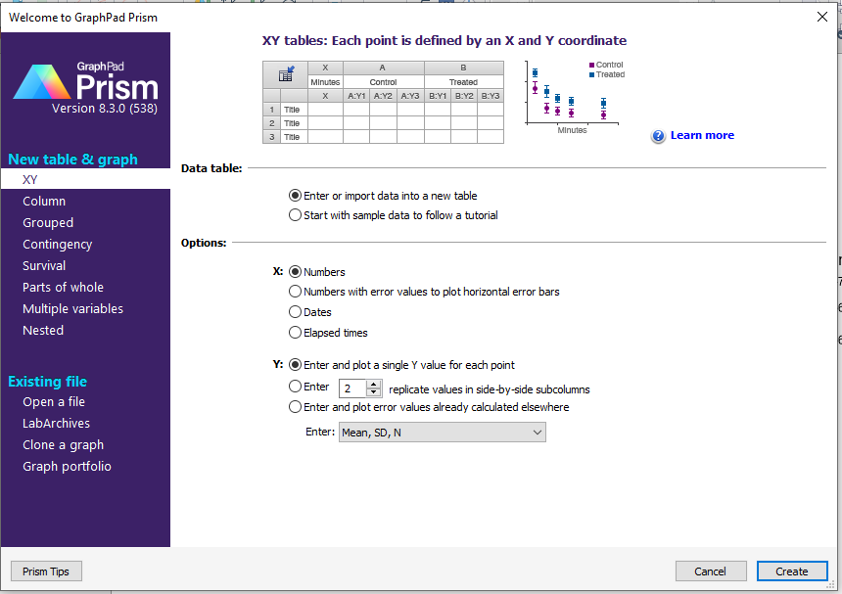
To continue, leave X as “numbers”, for Y: click “Enter and plot single Y value…”, then press “Create”.

Slide 4
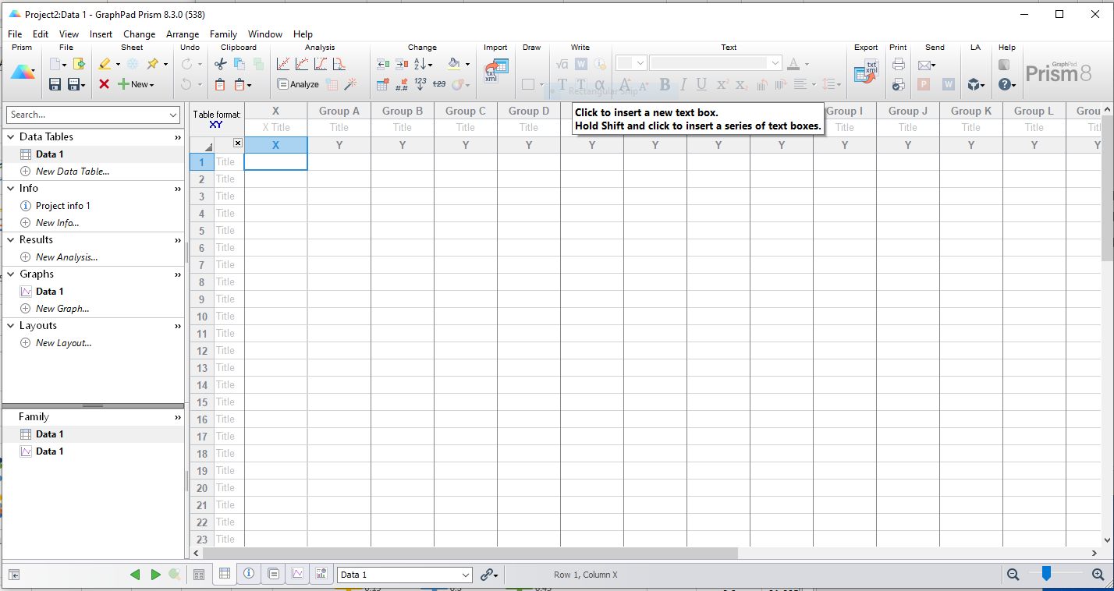
This is the table screen that comes up…

Slide 5
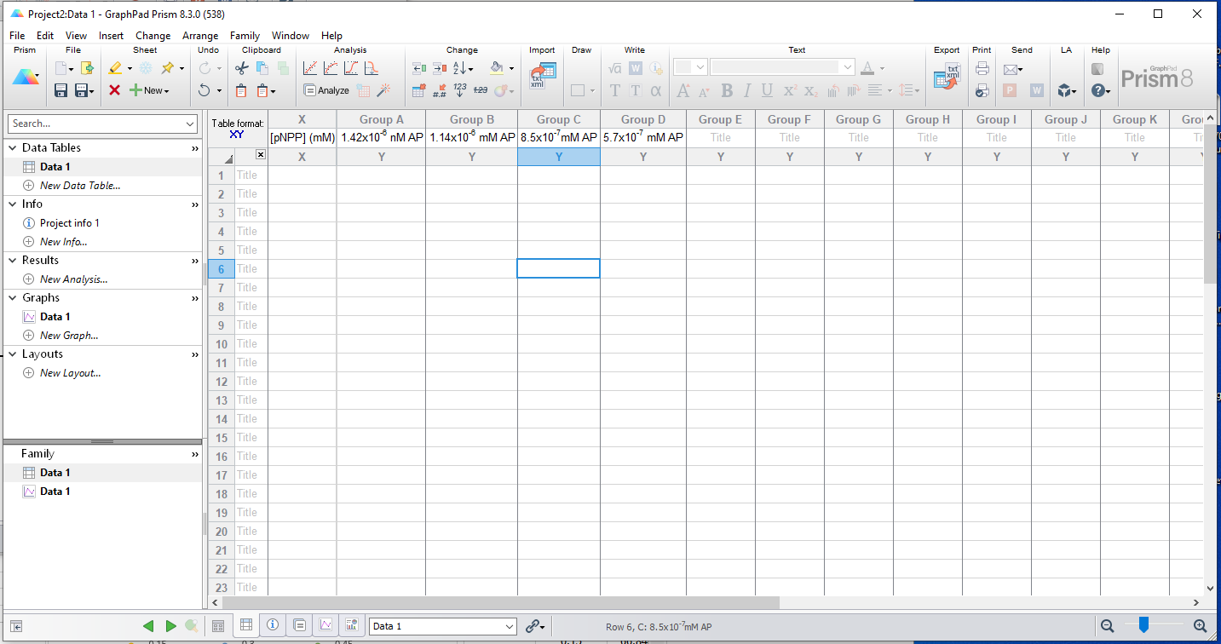
Click on ‘X title” to label X data, and “Y title” to label Y series.

Slide 6
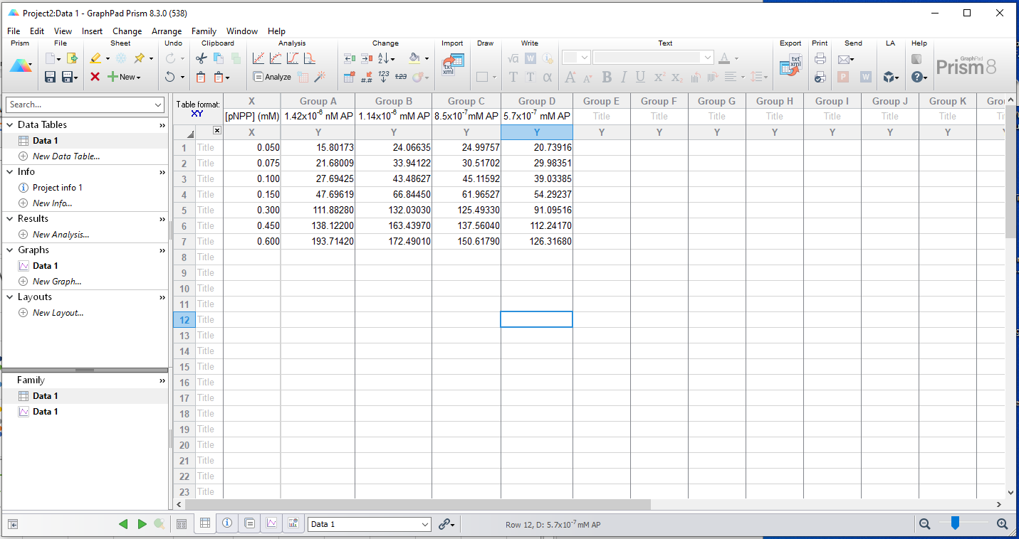
Copy and paste Vo and [S] data that you calculated from your Excel spreadsheet into Prism

Slide 7
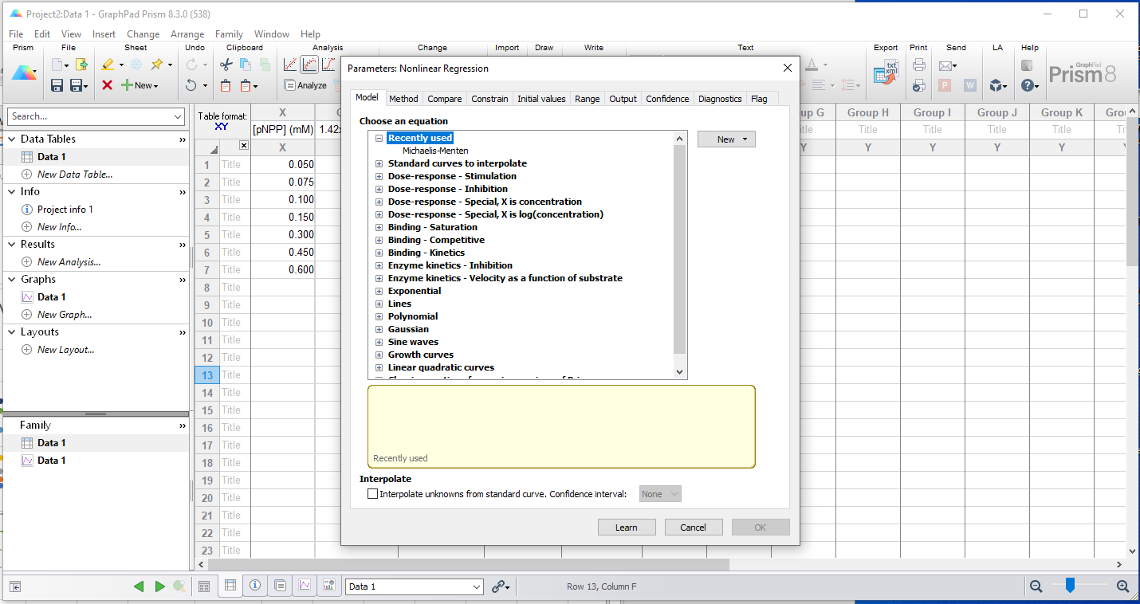
Under “Analysis” click on the graph icon for ‘Nonlinear regression”

Slide 8
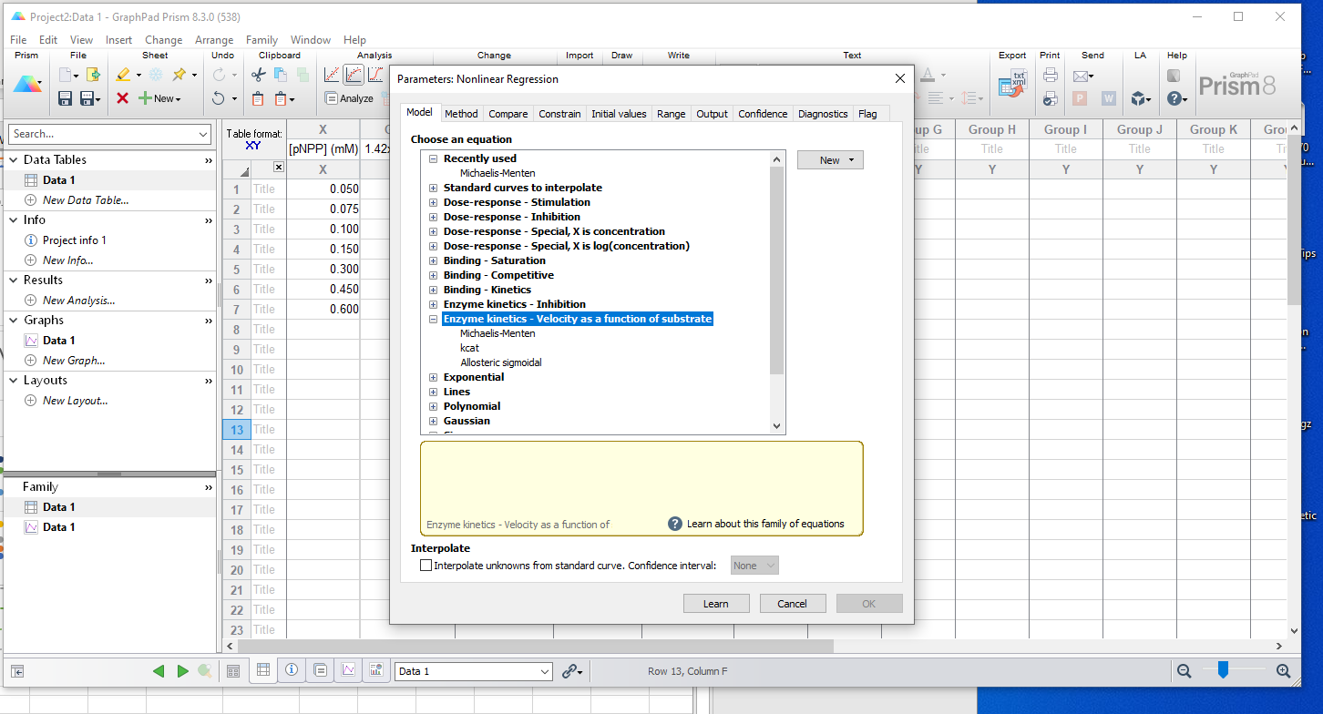
Now click “Enzyme Kinetics – Velocity…”

Slide 9
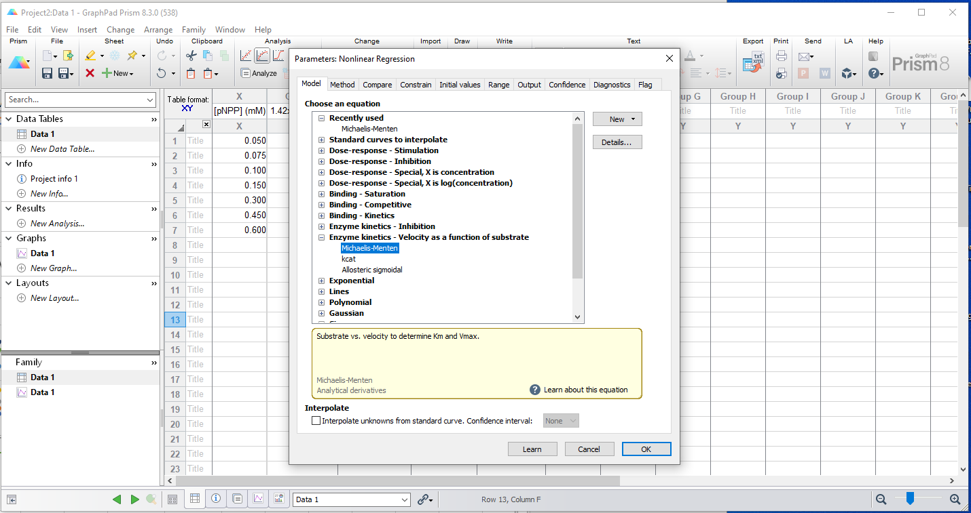
…and finally, choose “Michaelis-Menten”

Slide 10
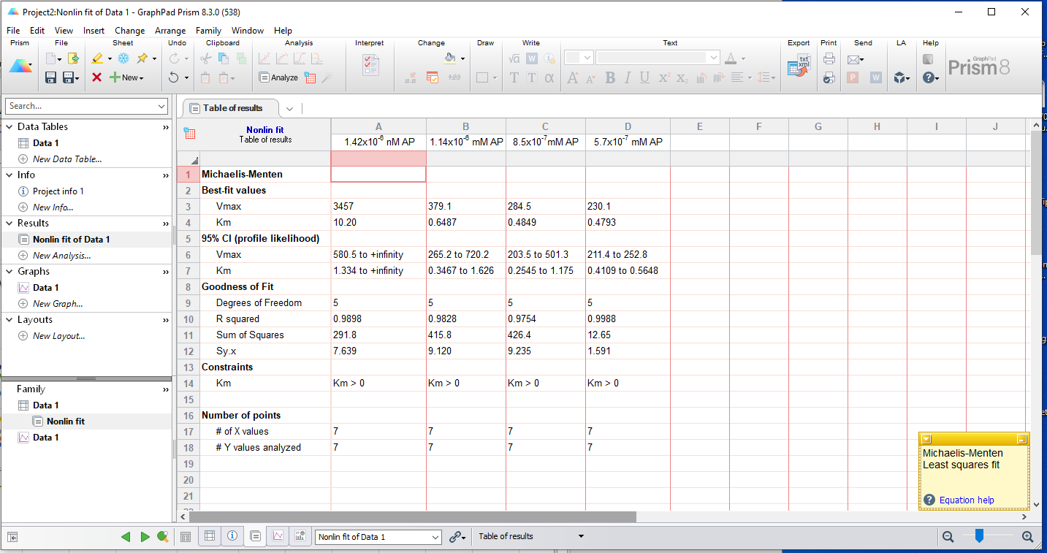
Your results will be displayed as follows…

Slide 11
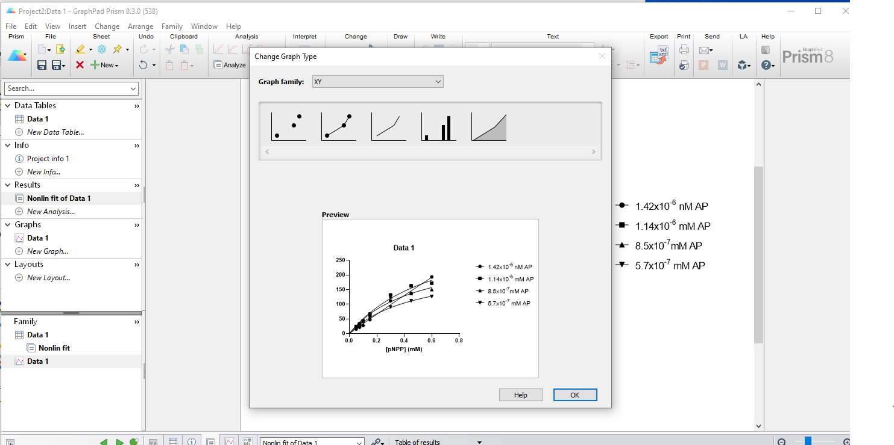
To look at the graph, go to left panel and click on ‘Data 1’ at the bottom, then click OK

Slide 12
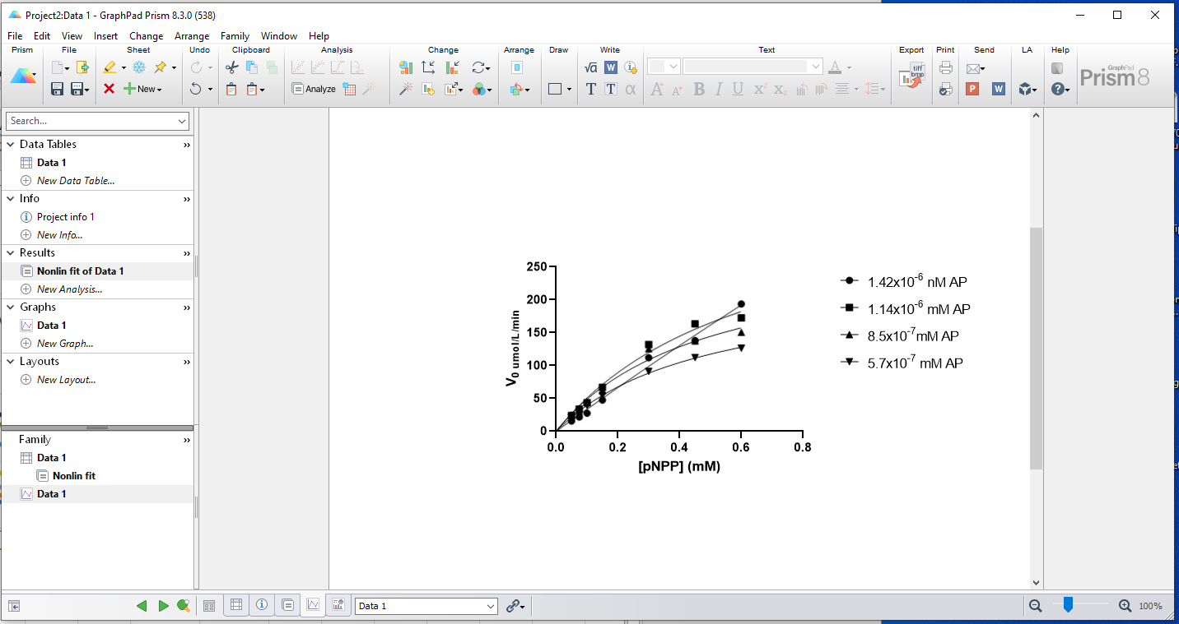
Now you can edit the Title and Y-axis as necessary, and print your graph.

